Slide 1
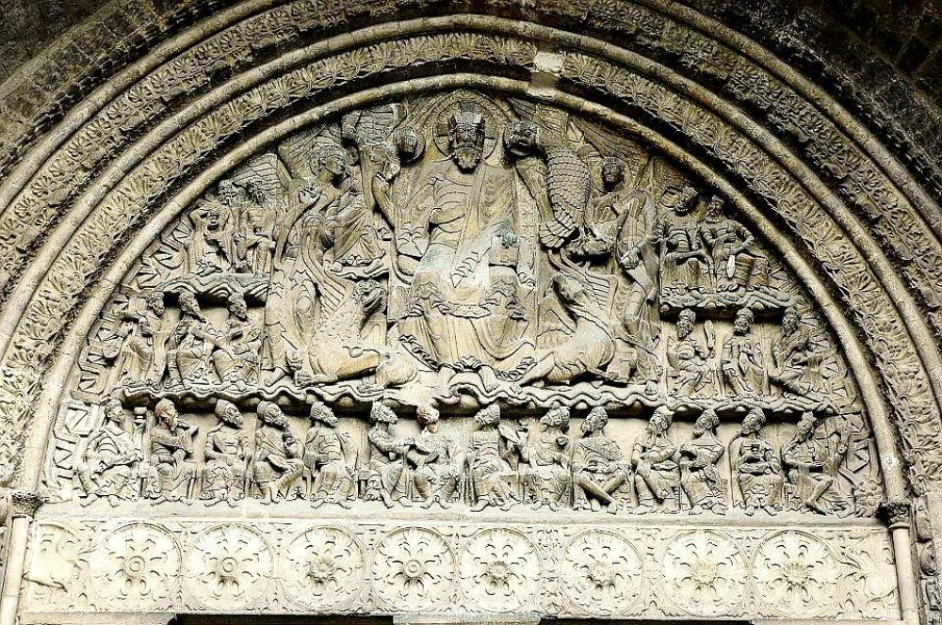
PAINTING AND SCULPTURE

Slide 2
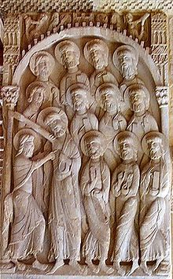
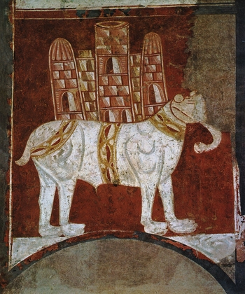
ROMANESQUE CHURCHES HAD RELIGIOUS PAINTINGS AND SCULPTURES AS DECORATION AND ALSO TO EXPLAIN THE SACRED EVENTS OF THE BIBLE
ANY PURPOSE?
YES, TO TEACH PEOPLE THE PRINCIPLES OF THE CHRISTIAN RELIGION

Slide 3
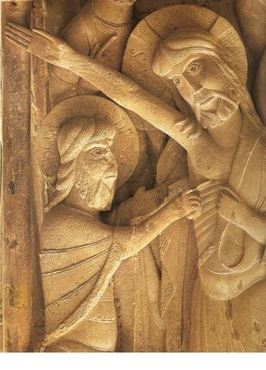
SO, THE ROMANESQUE SCULPTURE AND PAINTING HAD AN EDUCATIONAL OBJECTIVE:
THEY SHOULD TEACH THE BIBLE TO ILLITERATE PEOPLE

Slide 4
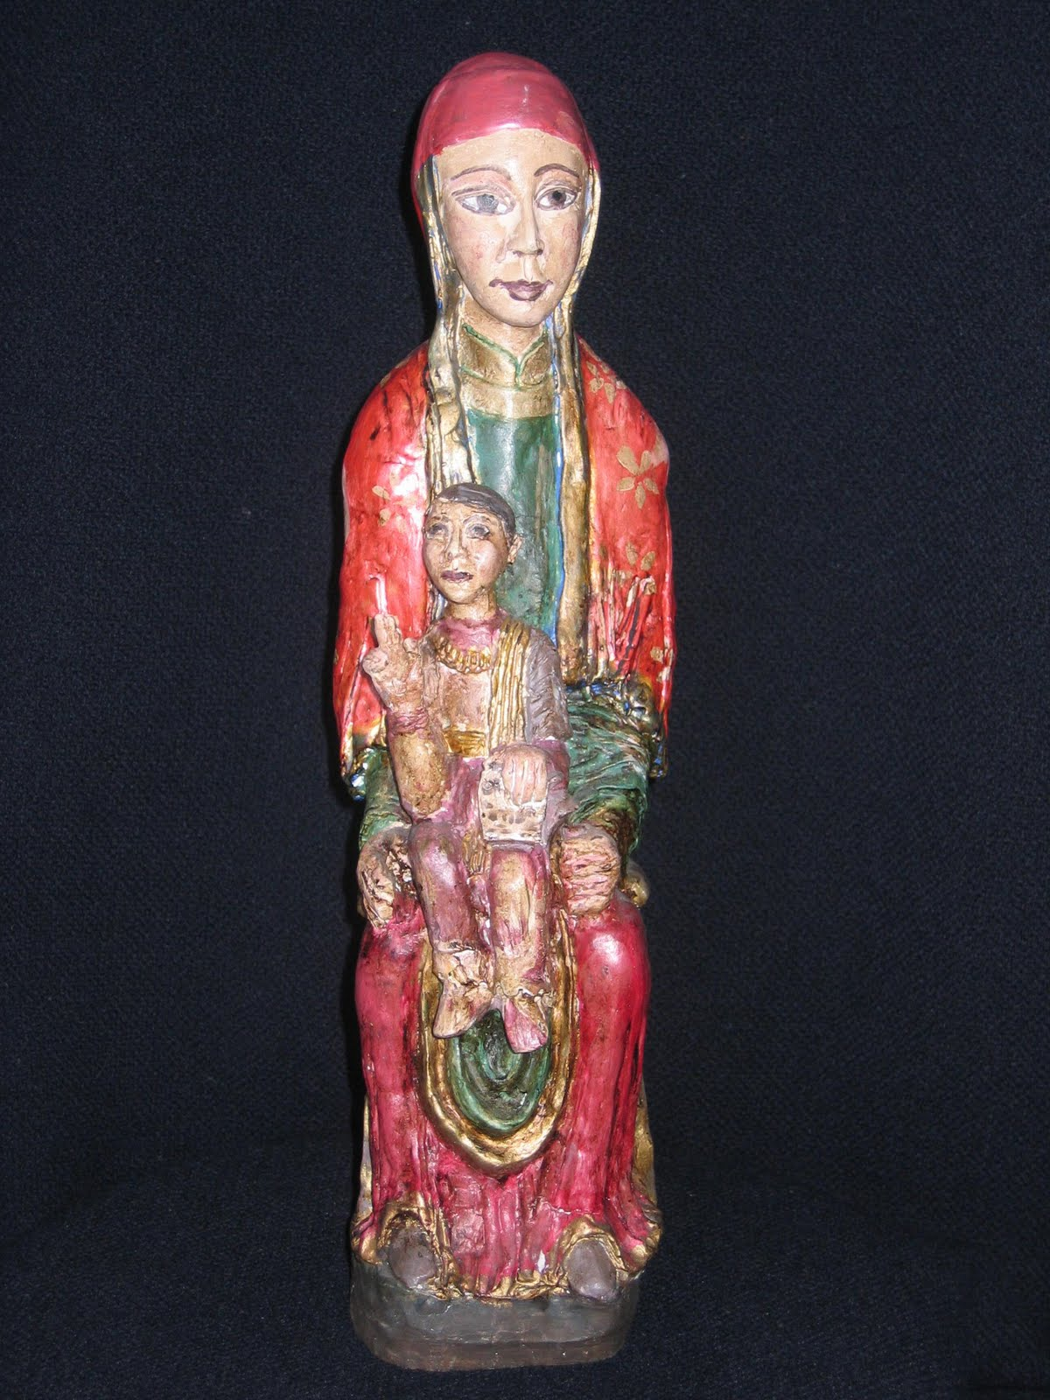
SCULPTURE

Slide 5
MAIN CHARACTERISTICS:
Images must adapt to the frame
They are distributed following criteria of hierarchy and symmetry
Lack of naturalism
Simplicity of the message
The main places for sculptural location
are portals and capitals

Slide 6
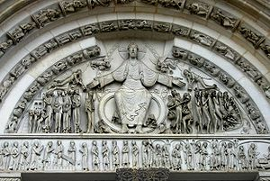
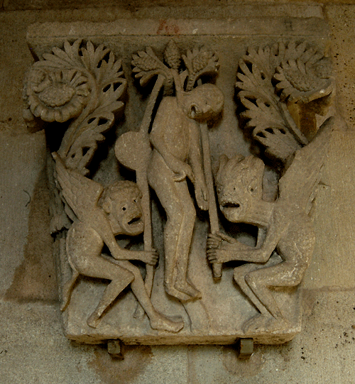
Images must adapt to the frame in which they are contained.
They follow criteria of hiearchy and symmetry
Lack of naturalism and simplicity of the message

Slide 7
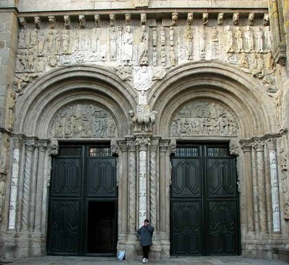
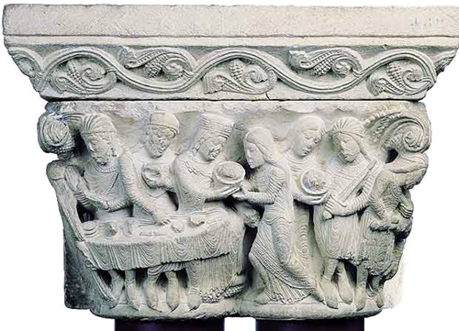
The main places for sculptural location are portals and capitals

Slide 8
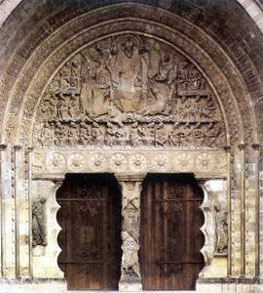
The location of the iconographic programme is always the same
In the archivolts subjects can vary from geometrical to human depictions
Tympanum is reserved for the depiction of the Last Judgement
Lintel is reserved for less important images or for geometrical depictions
Jambs are the place for saints sculptures

Slide 9
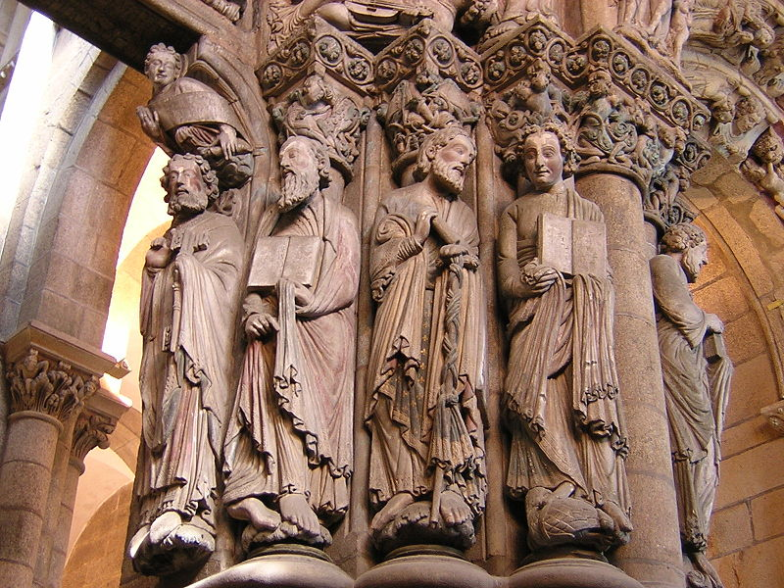
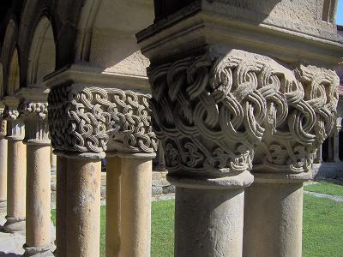
Jambs are the place for saints sculptures
Capitals are left for:
Biblical stories
Vegetal motives
Satirical depictions

Slide 10
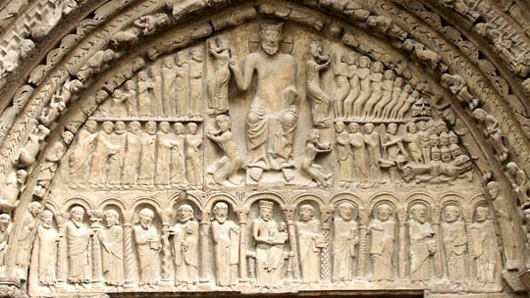
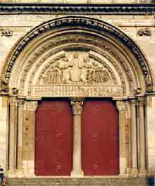
PARTS OF A PORTAL: TYMPANUM
The Tympanum depicts the Last Judgement
In the middle of it Christ appears as the Judge blessing the world.
He is sittingin the mandorle or almond
PARTS OF A PORTAL: ARCHIVOLTS
He is surrounded by the four evangelists as people or animals (Mark: lyon, Mathew: the man; Luke; the ox; John: the Eagle)
Around them people judged or the twenty-four wise men of the Apocalypse

Slide 11
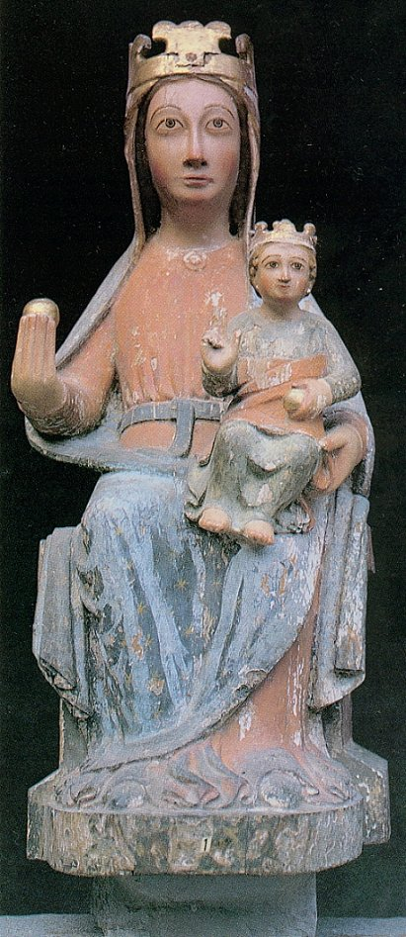
EXEMPT SCULPTURE: VIRGIN
It is based on the Byzantine Theotokos
Made of wood
The Virgin is a throne for her Son
Both of them appear looking at the front
They are blessing the world
There is no difference of age, just size
They are disproportionate
With time, they evolved and the position of the Son varied to be a bit more realistic
They wer polychrome

Slide 12
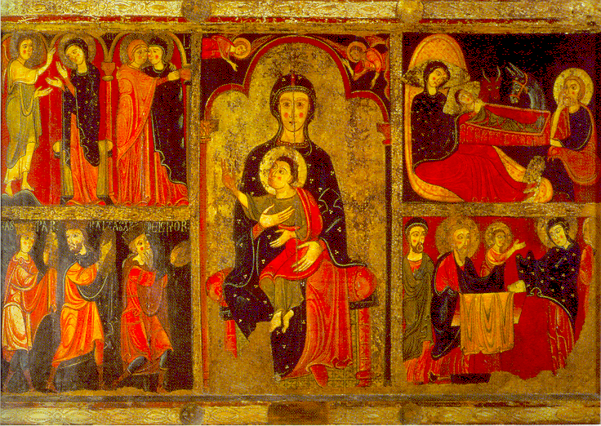
PAINTING

Slide 13
MAIN CHARACTERISTICS:
Romanesque painting, the same as sculpture, is at the service of architecture
It has a marked didactic character
The most common location is inside the churches, decorating walls.
The themes are, almost exclusivively, religious
Simplicity of the message

Slide 14
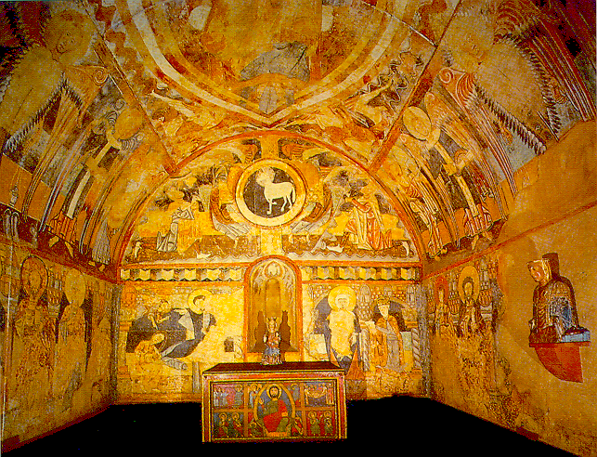
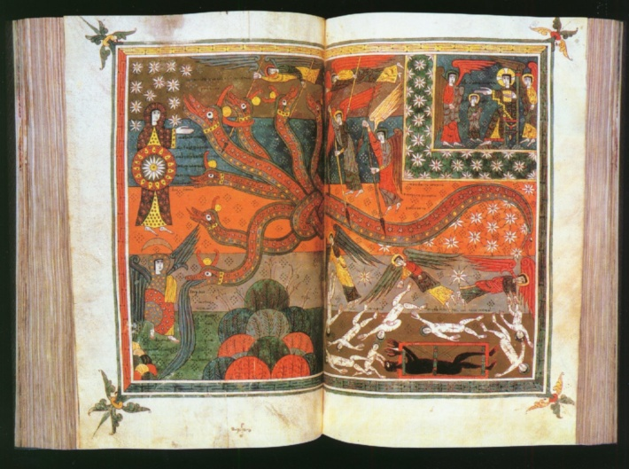
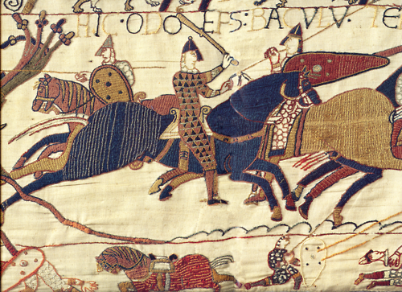
TECHNIQUES AND SUPPORTS
ON WALL, MAINLY IN APSES: FRESCO
ON WOOD:
ALTAR FRONTALS
ON CODEX: MINIATURE
IN CLOTHES: TAPESTRY

Slide 15
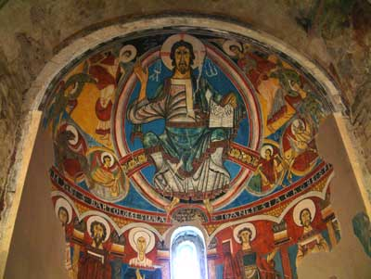
WALL PAINTING
THERE IS A HIERARCHY OF THE CHARACTERS: CHRIST OF THE VIRGIN APPEAR IN THE MIDDLE, IN BIGGER SIZE
AROUND THEM ANGELS OR EVANGELISTS. OTHER SAINTS IN A LOWER POSITION.
NATURAL ELEMENTS: ANIMALS AND PLANTS, NEAR THE FLOOR
IMAGES ARE NOT FRIENDLY AND ARE FULL OF CONVENTIONALISM

Slide 16
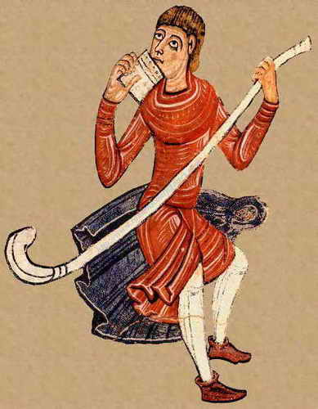
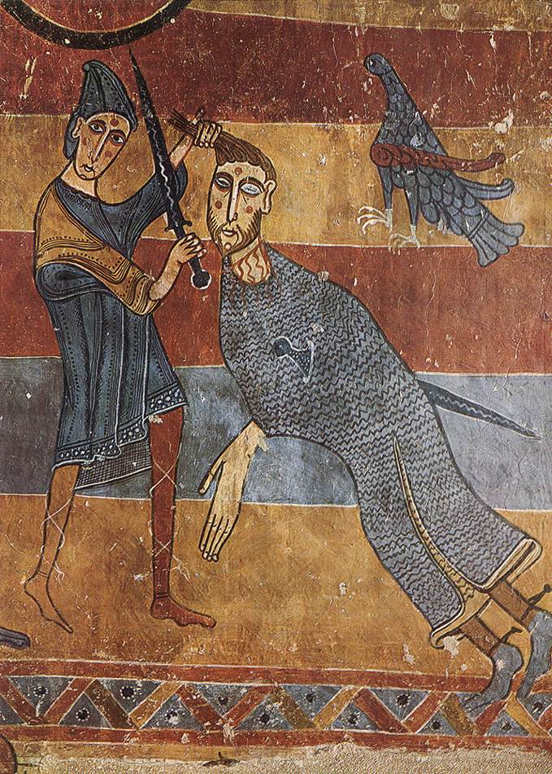
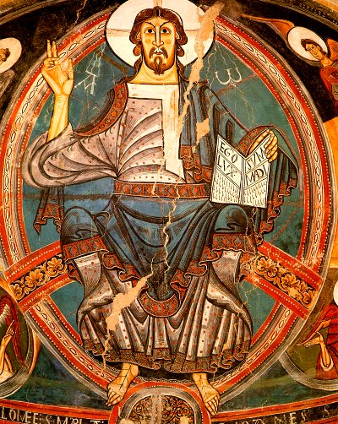
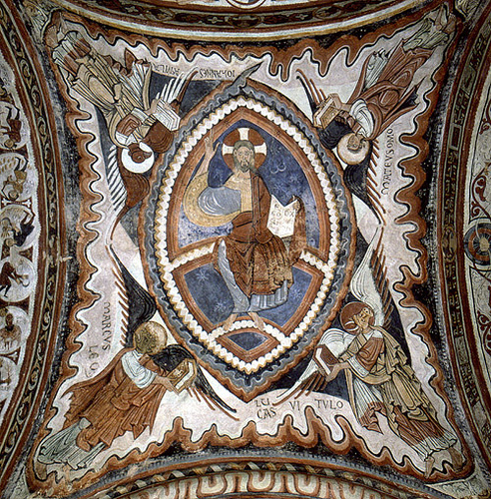
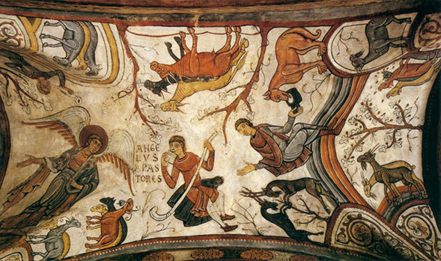
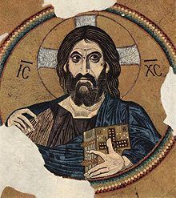
THE MAIN ICONOGRAPHY IS THAT OF THE PANTOCRATOR OR THE CHRIST DEPICTED AS A JUDGE IN A THREATENING WAY
IMAGES LOOK AT THE FRONT
COLOURS ARE FLAT, WITHOUT SHADES OR DIFFERENCES OF TONALITY
THEY DON´T USE PERSPECTIVE
IMAGES ARE LIMITED BY THICK BLACK LINES
TO GIVE THE IMPRESSION OF DEEPNESS THEY DRAW PARALLEL LINES

Slide 17
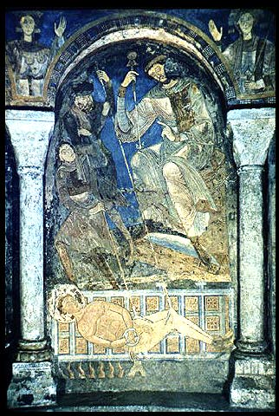
Figures are generally sized according to importance, not in accordance with perspective.
Volume, perspective and proportion between elements are not important.

Slide 18
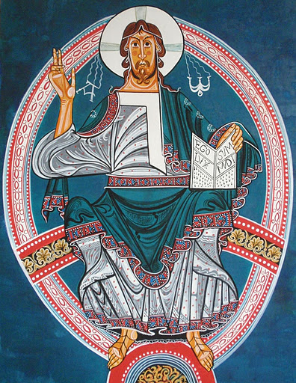
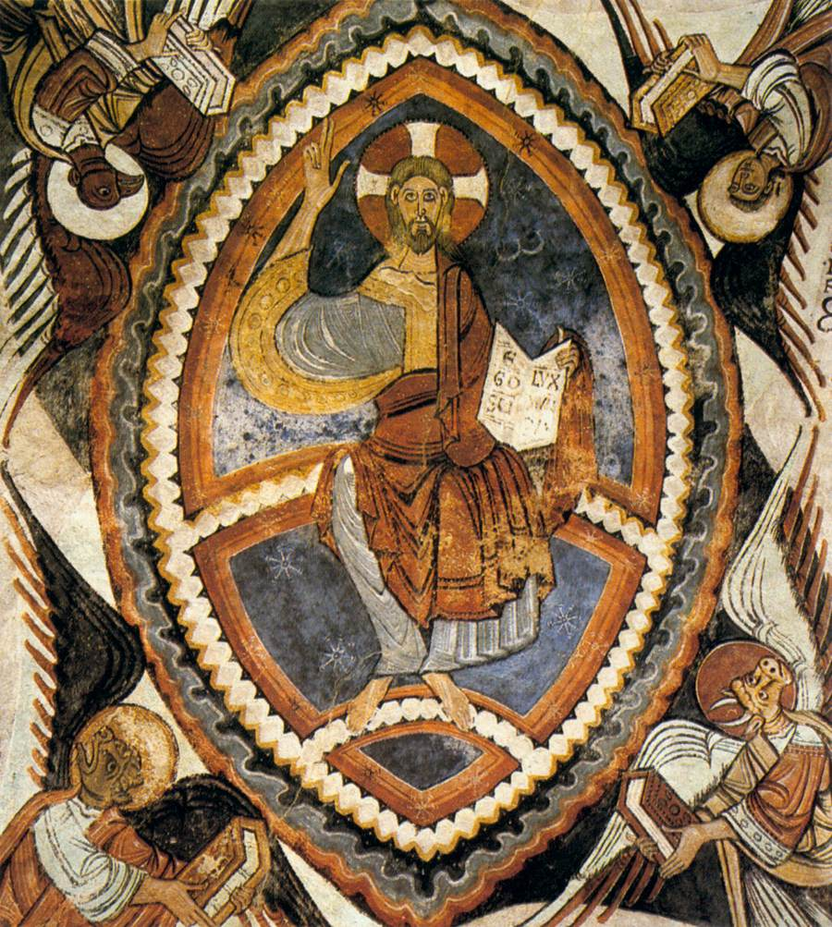
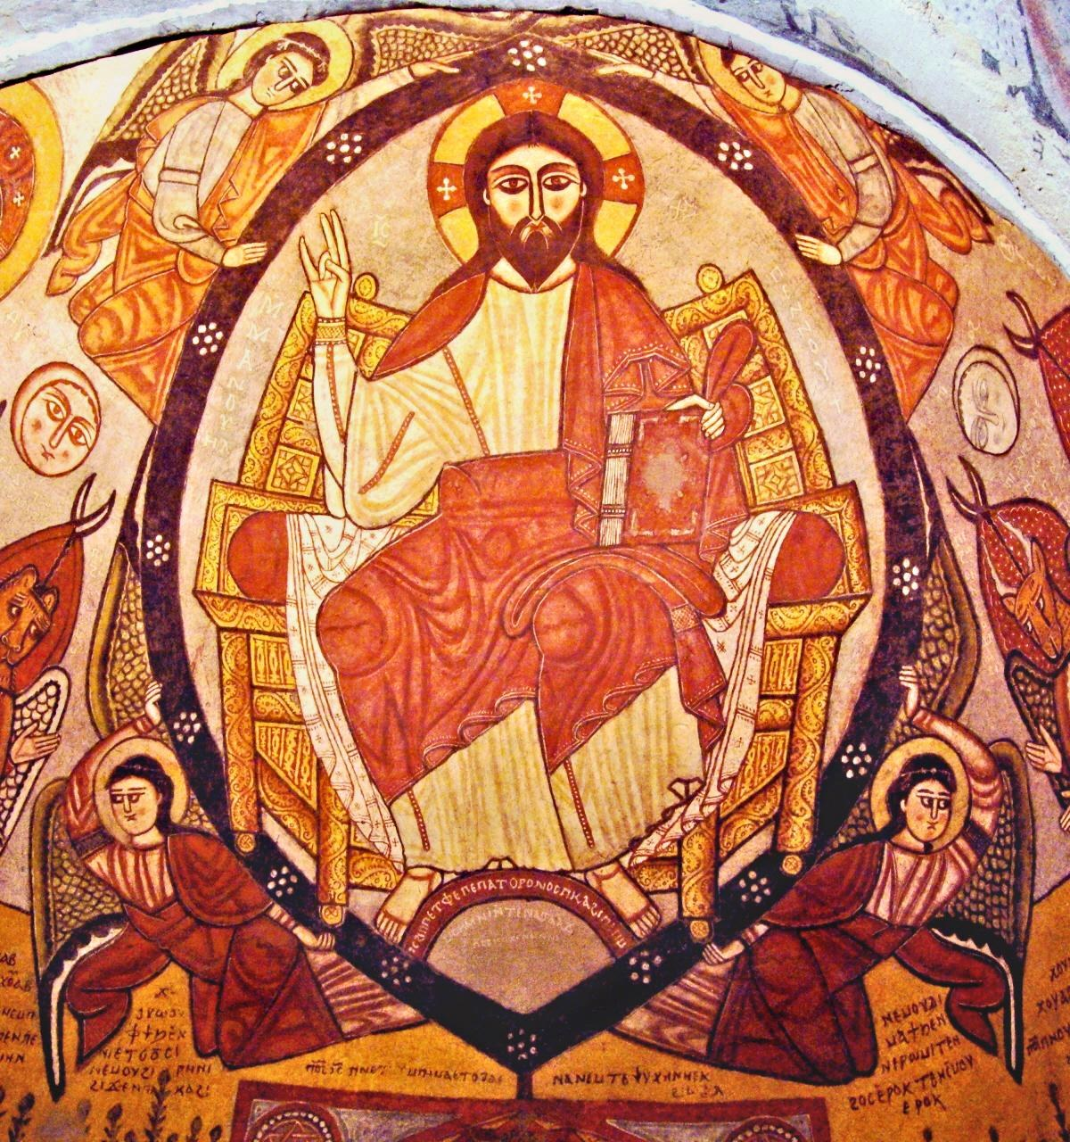
ICONOGRAPHY
THE PANTOCRATOR IS ALWAYS BLESSING: HIS RIGHT HAND MAKE THIS SIGNAL
WITH THE LEFT HAND HE HOLDS A BOOK IN WHICH IT CAN BE READ: “EGO SUM LUX MUNDI”
IN BOTH SIDES APPEAR THE LETTERS ALPHA AND OMEGA, FIRST AND LAST LETTERS OF THE GREEK ALPHABET SIMBOLIZES THAT CHRIST IS THE BEGINNING AND THE END OF EVERYTHING

Slide 19
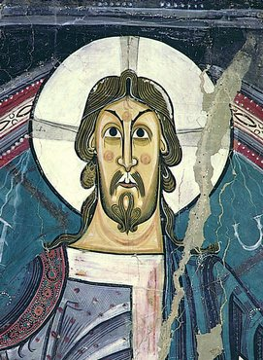
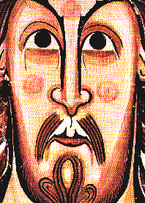
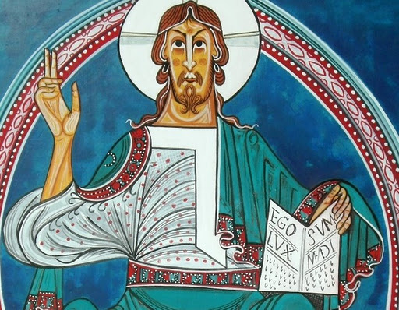
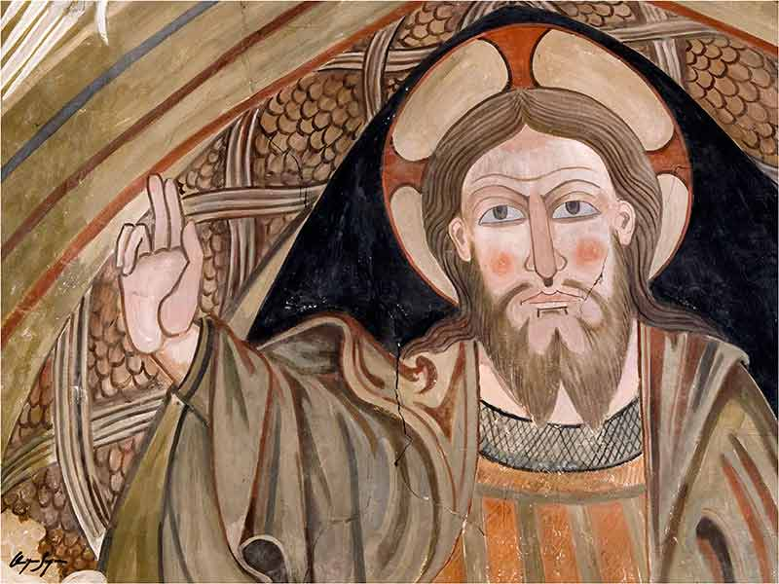
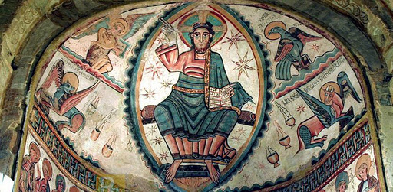
ICONOGRAPHY
THE CHRIST IS NORMALLY SITTING ON A BAND THAT SYMBOLIZES THE SKY
HIS FEET STAND ON A BALL THAT IS THE DECPICTION OF THE EARTH
THE COLOUR OF THE FACE IS DEPICTED WITH COLOURED CIRCLES
EYES ARE ENORMOUS AND INEXPRESSIVE
HANDS ARE TOO LONG, THE SAME AS OTHER FEATURES
IT IS A POWERFUL GOD, NOT A PITIFUL ONE

Slide 20
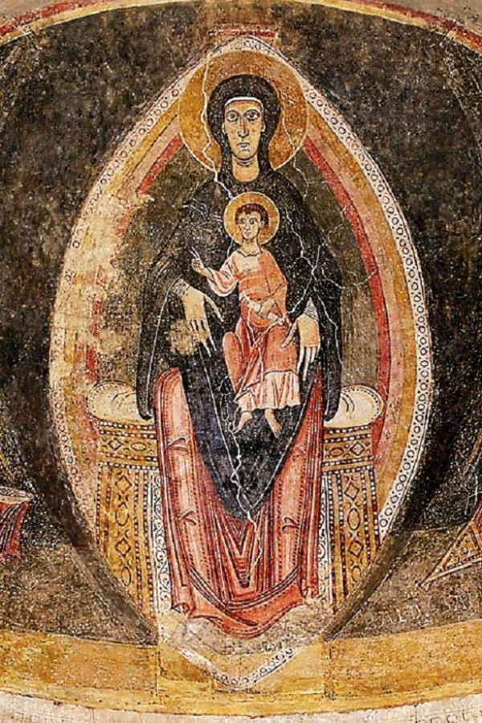
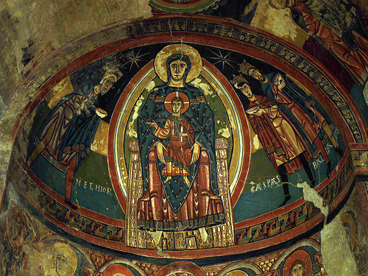
ICONOGRAPHY
THE VIRGIN APPEARS ALWAYS WITH HER SON
IT IS THE HEIR OF THE BYZANTINE THEOTOKOS
THEY APPEAR INSIDE THE MANDORLE THE SAME AS THE PANTOCRATOR
THE CHILD IS BLESSING
VIRGIN IS THE THRONE FOR HER SON

Slide 21
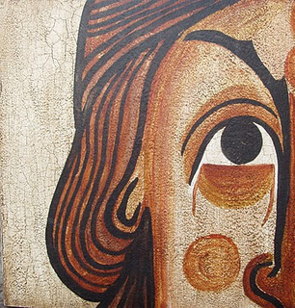
ANY QUESTIONS

