Slide 1
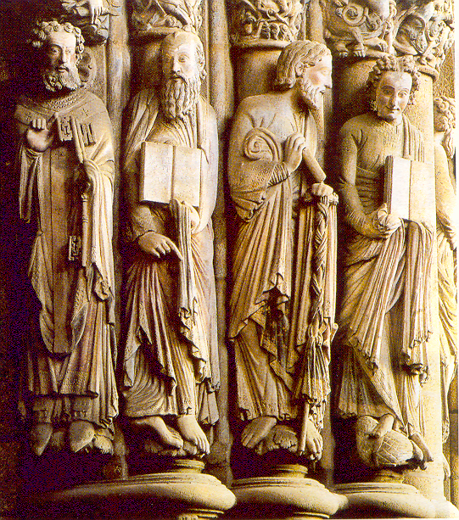
ROMANESQUE ART
ARCHITECTURE

Slide 2
QUESTIONS TO THINK ABOUT?
REASONS TO DEVELOP A NEW ART IN THIS PERIOD
WHY DO WE SAY THAT THIS IS THE FIRST EXAMPLE OF AN INTERNATIONAL ARTISTIC MOVEMENT?
EXPLAIN THE REASONS
COULD YOUR RELATE THE TERM ROMANESQUE TO OTHER STYLES?
HOW?
WHAT IS THE CONNECTION BETWEEN THE ROMANESQUE STYLE AND THE CHURCH?

Slide 3
WHAT IS ROMANESQUE ARCHITECTURE?
Romanesque architecture is a style of architecture that appeared in the most developed regions of Europe (Lombardy, Bourgogne and Normandy) and then expanded over the rest of Europe
WHAT DOES THE TERM ROMANESQUE REFER TO?
The term Romanesque was first given to this type of architecture in the 19th Century due to its similarities between the barrel vault and the Roman arch.
WHAT IS THE CHRONOLOGY OF ROMANESQUE ARCHITECTURE?
This art developed about 1000, once the Christian states of Europe had began a slow process of recovery after the period of invansions during the 11 and 12 centuries most of Romanesque churches were built.

Slide 4
ROMANESQUE ART WAS ALSO USED IN MOST CHURCHES BUILT IN PILGRIM ROUTES, MAINLY TOWARDS ROME AND SANTIAGO DE COMPOSTELA
MOST OF THE ROMANESQUE BUILDINGS WERE RELIGIOUS. THIS SHOWS THE HUGE IMPORTANCE OF RELIGION IN MEDIEVAL SOCIETY
CLUNIAC MONASTERIES STARTED THE REFORM OF THE WESTERN CHURCH.
THE NEW STYLE EXPANDED AROUND EUROPE
THE EXPANSION OF ROMANESQUE ART WAS CONNECTED TO THE STRENGTHENING OF THE CHURCH ON THE CONTINENT

Slide 5
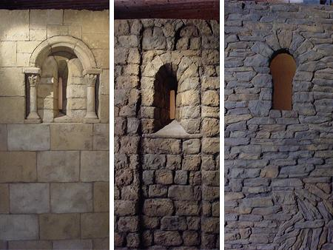
FEATURES OF THE ROMANESQUE STYLE
THICK WALLS MADE OF STONE
(AS A CONSEQUENCE, FEW WINDOWS AND DARK INTERIORS)
WHY?
TO MAKE THEM LAST FOREVER
TO AVOID FIRES
TO HOLD THE HEAVY ROOFS COVERED WITH VAULTS

Slide 6
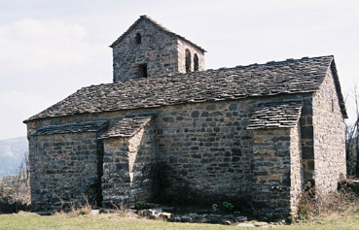
USE OF BUTRESSES (PILLARS NEXT TO THE WALLS)
WHY?
AS THE DOMES AND VAULTS WERE VERY HEAVY THEY ALSO BUILT BUTTRESSES TO REINFORCE THE WALLS

Slide 7
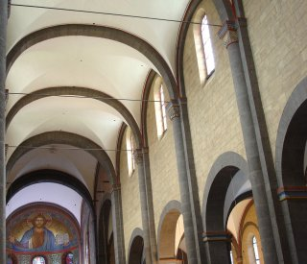
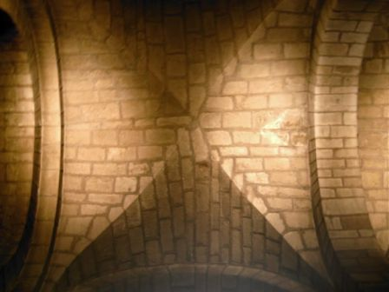
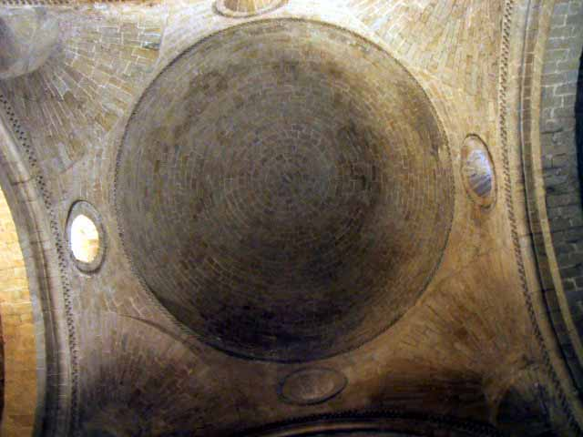
USE OF BARREL VAULTS, GROIN VAULTS AND DOMES
WHY?
SINCE THE ARCHITECTS DECIDED TO BUILD THE CHURCHES WITH STONE, THEIR ROOFS NEEDED ROMANESQUE TECHNIQUES SUCH AS THESE VAULTS TO COVER THE LARGE BUILDINGS

Slide 8
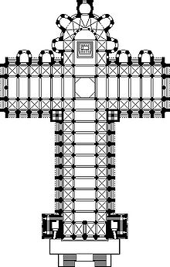
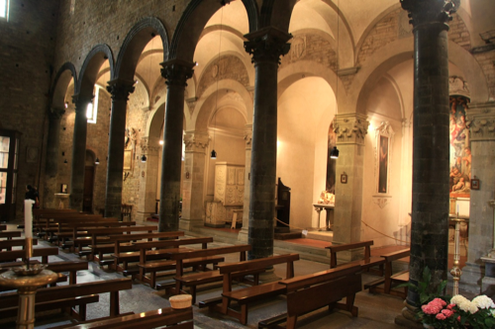
THE FLOOR PLAN WAS IN THE SHAPE OF A LATIN CROSS
WITH LATERAL AISLES SEPARATED BY LARGE ARCHADES
WHY?
THERE WERE LOTS OF PILGRIMAGES TO VISIT SITES OF SAINTS AND MARTYRS. PEOPLE BELIEVED THAT HOLY RELICS HAD THE POWER TO DO MIRACLES. THE ROUTES TO THE MORE FAMOUS HOLY PLACES, SUCH AS SANTIAGO, REQUIRED LARGER BUILDINGS TO HOLD THE LARGE CROWDS. THE BASILICA STYLE COULD NOT HOLD THE LARGE CROWDS WHO WERE COMING. THEY BEGAN TO BUILD CHURCHES IN THE SHAPE OF THE LATIN CROSS
Notes:
During this time in Europe there was a very large interest in religion. Large numbers of people traveled on pilgrimages to visit sites of saints and martyrs. People believed that holy relics had the power to do miracles. The routes to the more famous holy places, such as Santiago, became very well traveled and required larger buildings to hold the large crowds. The basilica style church could not hold the large crowds which were coming. They began to build churches in the shape of the Latin cross. The pilgrim would enter the church through the nave. They would then come to the area known as the crossing, which was under a groin vault, where the vaults of the nave and the transepts would intersect. The relics of the church would be held and displayed in the area of the high alter. The pilgrims would be allowed to view the relics from the ambulatory which allowed for a good traffic pattern for these large crowds. The more famous the relics a church held, the larger the crowds it would attract.

Slide 9
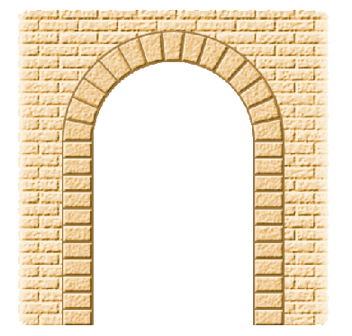
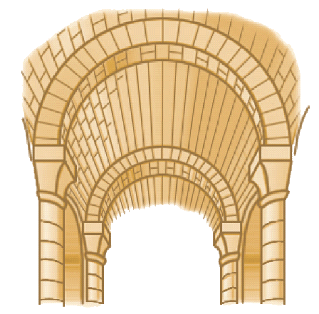
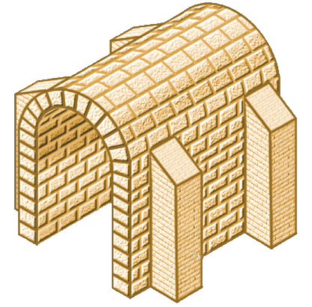
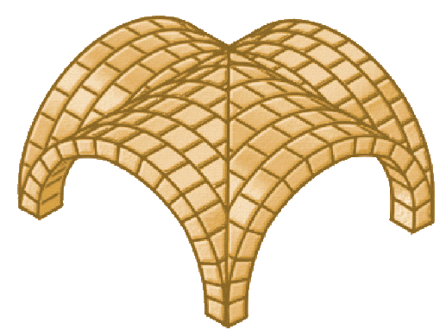
MAIN ELEMENTS
ROUND ARCH
BARREL VALULT OR ARCH VAULT
RIB OR GROIN VAULT
BUTTRESS

Slide 10
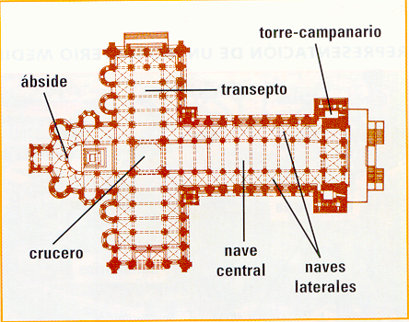
BELL TOWER
AMBULATORY
PORTAL
TRANSEPT
APSE
CROSSING
CENTRAL NAVE
AISLES OR SIDE NAVES
PLAN OF A ROMANESQUE CHURCH

Slide 11
PLAN OF A ROMANESQUE CHURCH

Slide 12
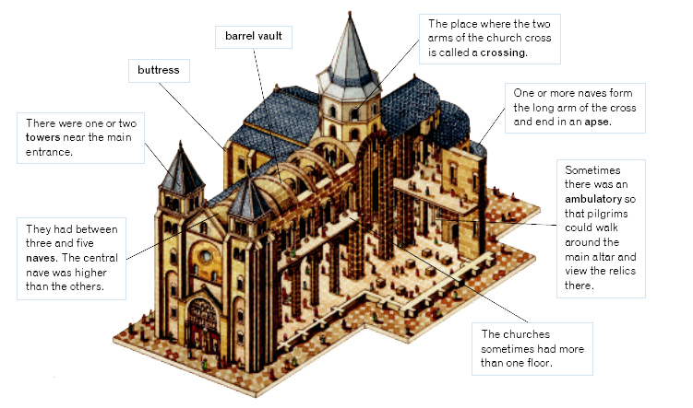
TOWER CROSSING
BASE OF DOME
CROSSING (THE PLACE WHERE THE TWO ARMS OF THE CHURCH CROSS
BARREL VAULT
APSE
BUTTRESS
APSE CHAPELS OR RADIAL CHAPELS
BELL TOWERS NEAR THE MAIN ENTRANCE
AMBULATORY FOR PILGRIMS WHO COULD WALK AROUND THE MAIN ALTAR
THEY HAD BETWEEN THREE AND FIVE NAVES. THE CENTRAL NAVE WAS HIGHER THAN THE OTHERS
TRANSEPT OR CROSSING AISLE
PORCH OR PORTAL
TRYFORIUM OR GALLERY
CRUCIFORM PIER
TYMPANUM AND ARCHIVOLTS
SIDE AISLE
FACADE
MULLION
JAMBS AND TRUMPED SHAFED PORCH

Slide 14
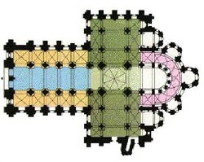
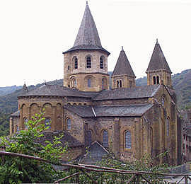
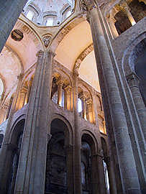
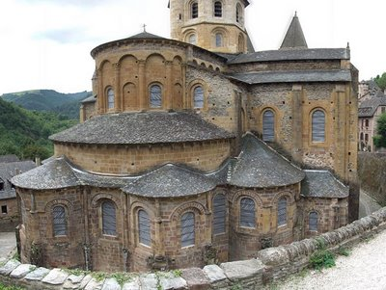
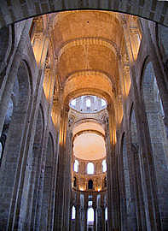
SAINTE-FOY IN CONQUES

Slide 15
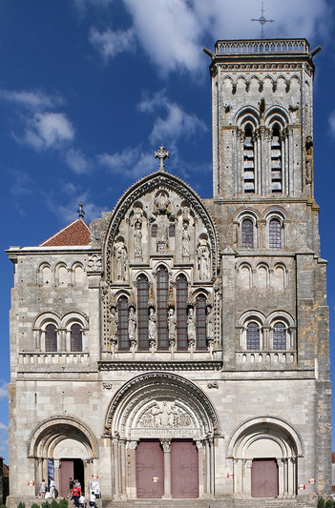
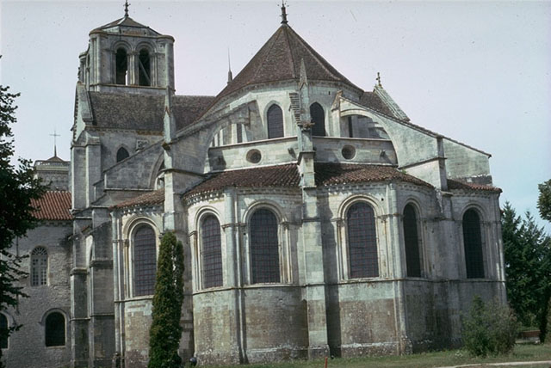
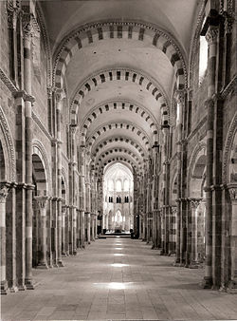
VEZELAY ABBEY

Slide 16
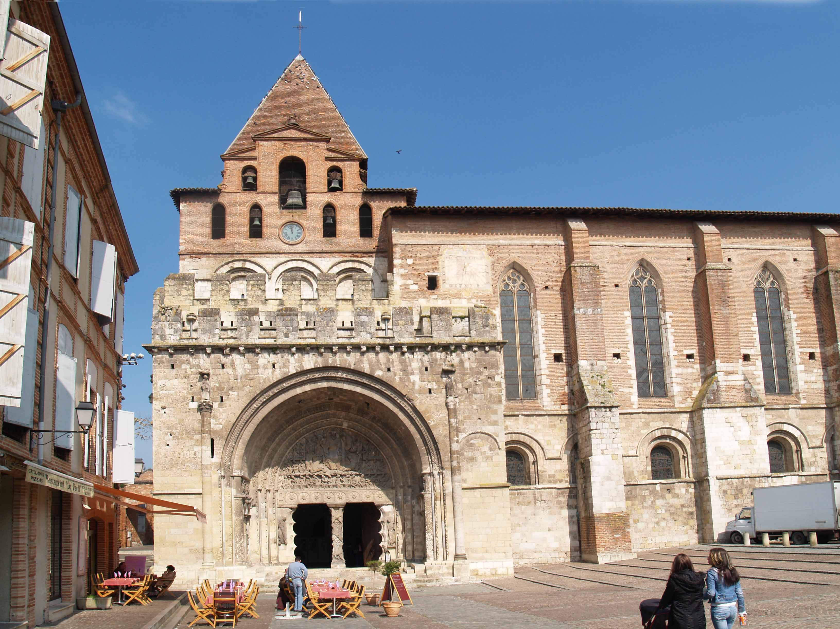
SAINT PETER´S IN MOISAC

Slide 17
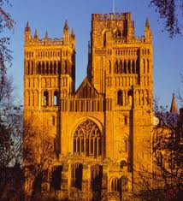
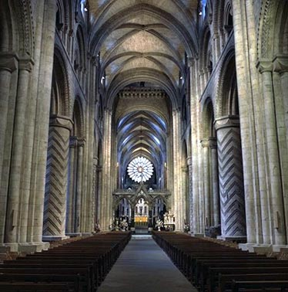
DURHAM CATHEDRAL

Slide 18
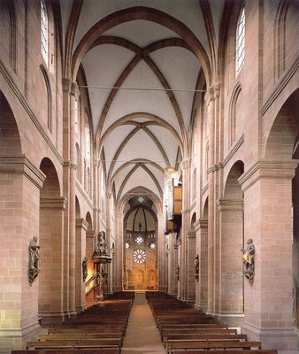
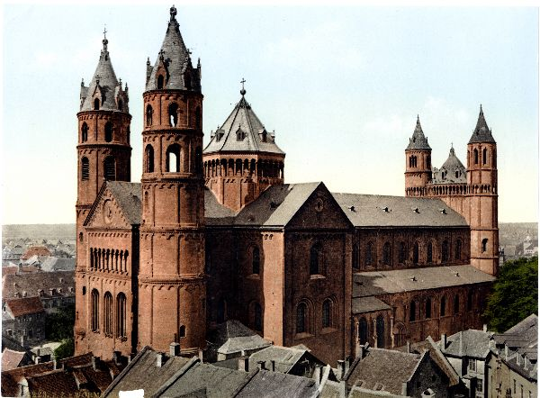
WORMS CATHEDRAL

Slide 19
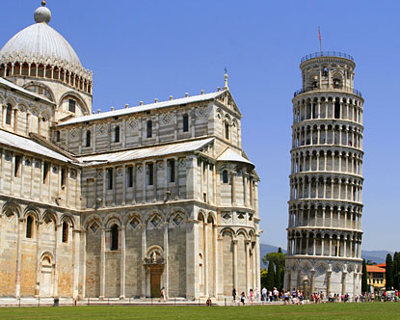
THE LEANING TOWER OF PISA

Slide 20
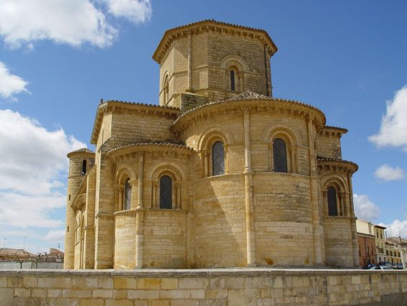
SAN MARTÍN DE FROMISTA

Slide 21
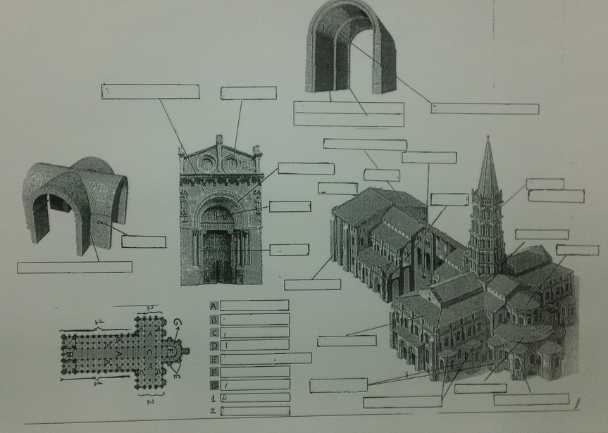

Slide 22
