Slide 1
GOTHIC ART
Notes:
Slide concept by William V. Ganis, PhD FOR EDUCATIONAL USE ONLY For publication, reproduction or transmission of images, please contact individual artists, estates, photographers and exhibiting institutions for permissions and rights.

Slide 2
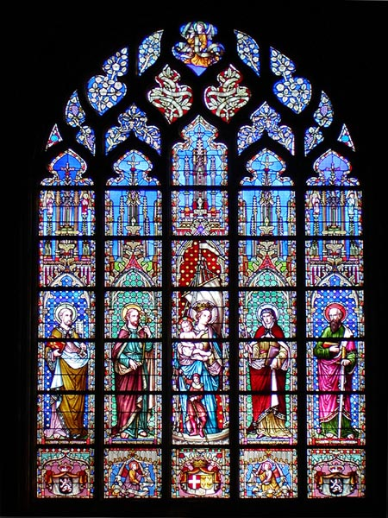
GOTHIC ART
A new type of art developed in Europe between the 12th and the 15th century. The Gothic style replaced Romanesque. It reflected the artistic interests of urban society and the emerging bourgeoisie.
It was called Gothic because during the Early Renaissance it was believed the Goths introduced the art.
In fact, it had its origin in the north of France and from there it spread throughout Europe.
Notes:
Slide concept by William V. Ganis, PhD FOR EDUCATIONAL USE ONLY For publication, reproduction or transmission of images, please contact individual artists, estates, photographers and exhibiting institutions for permissions and rights.

Slide 3
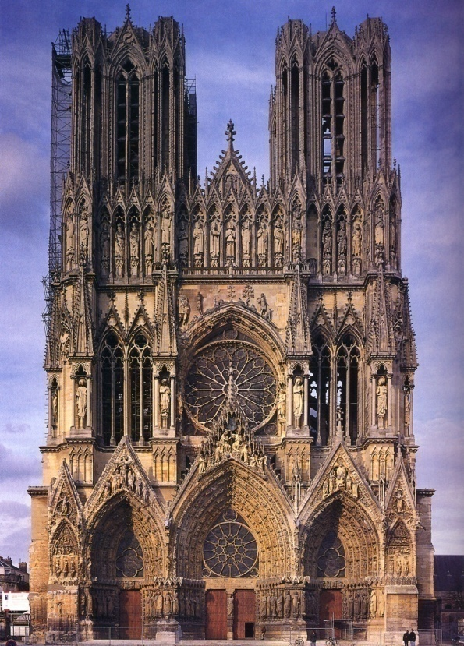
GOTHIC ARCHITECTURE: MAIN CHARACTERISTICS
The pointed arch
The ribbed vault
The flying buttress
The combination of these elements made the construction of tall buildings with large windows possible.
Cathedrals were the most important buildings. The symbol of religious power in cities but they also demonstrated the wealth and importance of a region. Their design followed the following characteristics:
The Latin cross plan and usually three storeys
Several chapels opened to the side
Stained glass windows and rose windows
The use of stone as construction material
The use of pillars to sustain the structure
Notes:
Slide concept by William V. Ganis, PhD FOR EDUCATIONAL USE ONLY For publication, reproduction or transmission of images, please contact individual artists, estates, photographers and exhibiting institutions for permissions and rights.

Slide 4
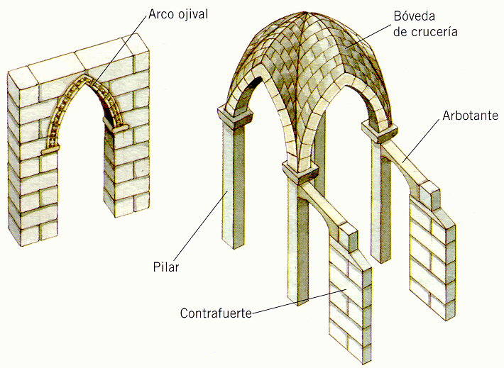
POINTED ARCH
RIBBED VAULT
FLYING BUTTRESS
PILLAR
EXTERNAL BUTTRESS
MAIN GOTHIC ARCHITECTURAL FEATURES
Notes:
Slide concept by William V. Ganis, PhD FOR EDUCATIONAL USE ONLY For publication, reproduction or transmission of images, please contact individual artists, estates, photographers and exhibiting institutions for permissions and rights.

Slide 5
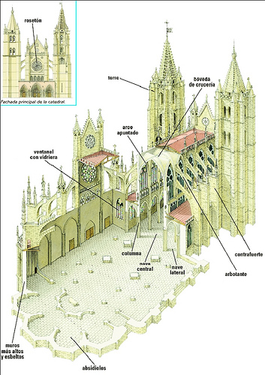
ROSE WINDOW
CLEARSTOREY
TOWER
RIBBED
VALULT
MAIN FACADE
POINTED ARCH
STAINED GLASS WINDOW
PINNACLE
PIER
BUTRESS
CENTRAL NAVE
AISLE
FLYING BUTRESS
HIGHER AND LIIGHTER WALLS
APSES
Notes:
Slide concept by William V. Ganis, PhD FOR EDUCATIONAL USE ONLY For publication, reproduction or transmission of images, please contact individual artists, estates, photographers and exhibiting institutions for permissions and rights.

Slide 6
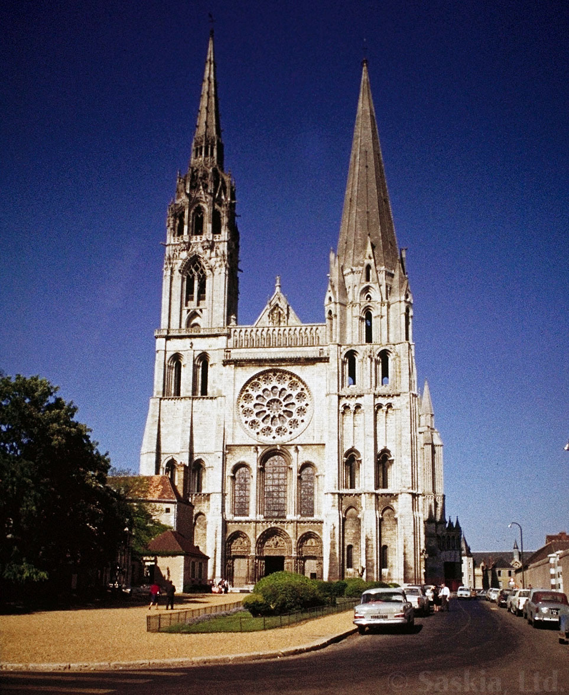
West facade of Chartres Cathedral
Chartres, France
begun 1134, rebuilt beginning 1194
Notes:
Slide concept by William V. Ganis, PhD FOR EDUCATIONAL USE ONLY For publication, reproduction or transmission of images, please contact individual artists, estates, photographers and exhibiting institutions for permissions and rights.

Slide 7
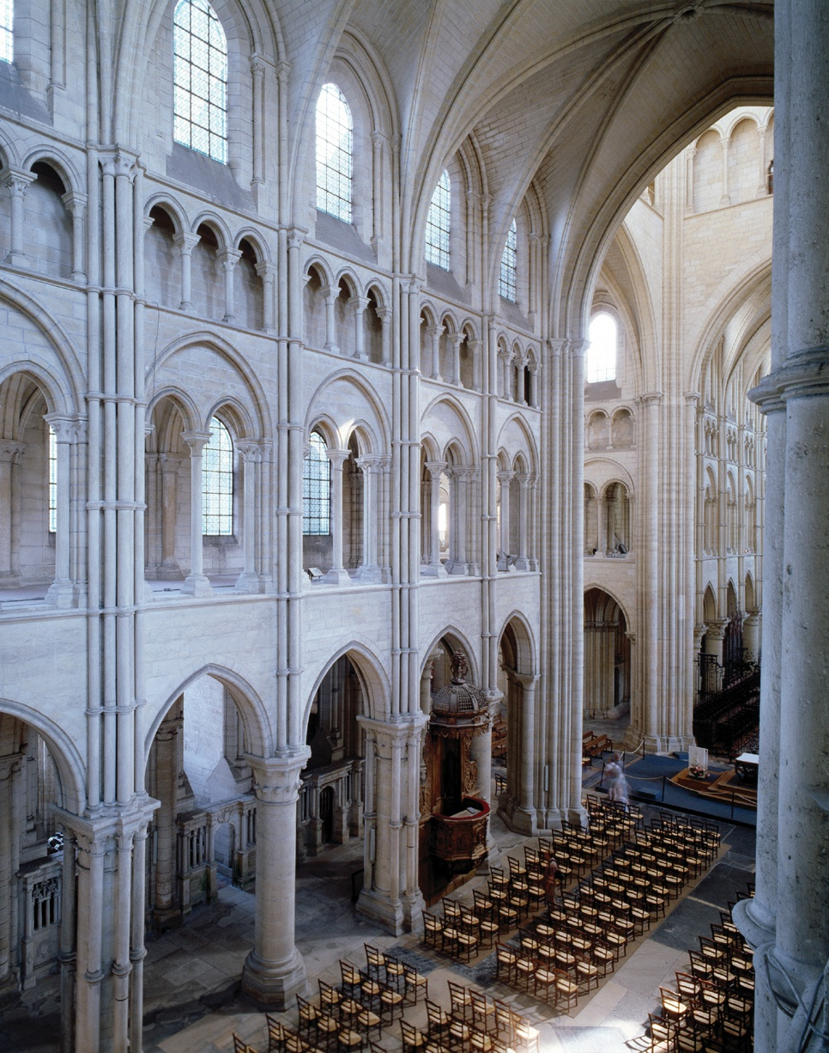
nave of Laon Cathedral
Laon, France
begun ca. 1190
Notes:
Slide concept by William V. Ganis, PhD FOR EDUCATIONAL USE ONLY For publication, reproduction or transmission of images, please contact individual artists, estates, photographers and exhibiting institutions for permissions and rights.

Slide 8
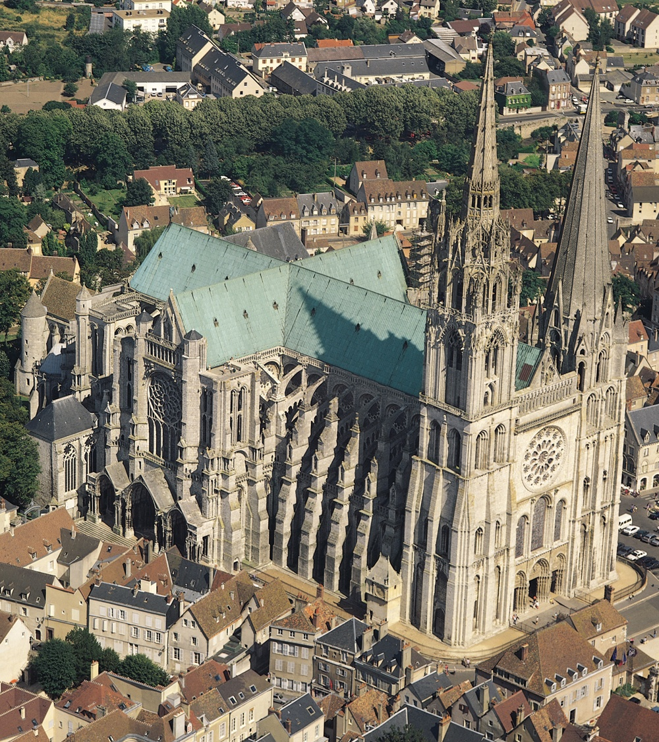
Chartres Cathedral
Chartres, France
begun 1134 rebuilt beginning 1194
Notes:
Slide concept by William V. Ganis, PhD FOR EDUCATIONAL USE ONLY For publication, reproduction or transmission of images, please contact individual artists, estates, photographers and exhibiting institutions for permissions and rights.

Slide 9
West façade of Reims Cathedral
Reims, France
begun ca. 1225-1290
Notes:
Slide concept by William V. Ganis, PhD FOR EDUCATIONAL USE ONLY For publication, reproduction or transmission of images, please contact individual artists, estates, photographers and exhibiting institutions for permissions and rights.

Slide 10
GOTHIC SCULPTURE
GOTHIC SCULPUTURE MAINTAINED THE MEDIEVAL TRADITION OF REPRESENTING RELIGIOUS SUBJECTS, AND WAS USED TO DECORATE CHURCHS AND CATHEDRALS
LIKE ROMANESQUE ART, EARLY GOTHIC SCULPTURE WAS MANLY ANONYMOUS, BUT THE NAMES OF SOME LATER SCULPTORS ARE KNOWN TO US
THERE WERE A NUMBER OF DIFFERENCES COMPARED TO ROMANESQUE SCULPTURE
1
GOTHIC SCULPTURE WAS MORE NATURALISTIC. FIGURES WERE MORE REALISTIC AND EXPRESSIVE. THEY WERE BETTER PROPORTIONATED AND INTERACTED WITH EACH OTHER TO CREATE SCENES
2
IT WAS MORE DYNAMIC. CURVED LINES WERE GRADUALLY INTRODUCED TO SUGGEST MOVEMENT
3
IT WAS INDEPENDENT OF ARCHITECTURE. FREE STANDING STATUES WERE CREATED THAT COULD BE VIEWED FROM ALL SIDES
Notes:
Slide concept by William V. Ganis, PhD FOR EDUCATIONAL USE ONLY For publication, reproduction or transmission of images, please contact individual artists, estates, photographers and exhibiting institutions for permissions and rights.

Slide 11
TYPES OF SCULPTURE
RELIEFS
RELIEFS WERE STILL USED TO DECORATE THE FAÇADES OF CATHEDRALS AND CHURCHES
REALISTIC PORTRAITS
REALISTIC PORTRAITS WERE MADE OF KINGS, NOBLES AND BISHOPS. THEY WERE USED TO DECORATE THEIR TOMBS
ALTARPIECES
ALTARPIECES WRE PLACED BEHIND THE ALTARS IN CHURCHES AND CATHEDRALS, COMBINING SCULPTURE AND PAINTING
CHOIR STALLS
CHOIR STALLS WERE CARVED WOODEN SEATS WHERE THE CLERGY WERESEATED DURING RELIGIOUS SERVICES
GARGOYLES
GARGOYLES WERE FANTASTIC REPRESENTATIONS OF GROTESQUE CREATURES THAT DECORATED THE ROOFS OF CATHEDRALS
Notes:
Slide concept by William V. Ganis, PhD FOR EDUCATIONAL USE ONLY For publication, reproduction or transmission of images, please contact individual artists, estates, photographers and exhibiting institutions for permissions and rights.

Slide 12
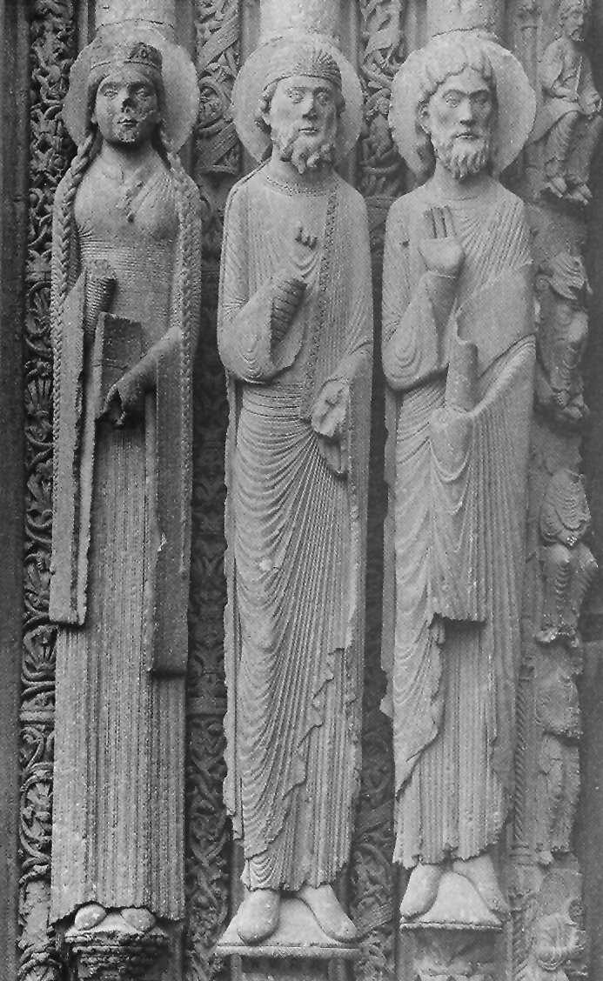
Old Testament queen and two kings jamb statues, doorway of Royal Portal
Chartres Cathedral
Chartres, France
ca. 1145-1155
Notes:
Slide concept by William V. Ganis, PhD FOR EDUCATIONAL USE ONLY For publication, reproduction or transmission of images, please contact individual artists, estates, photographers and exhibiting institutions for permissions and rights.

Slide 13
GOTHIC PAINTING
LIKE SCULPTURE, GOTHIC PAINTING WAS MORE NATURALISTIC AND EXPRESSIVE THAN EARLIER ART
GOTHIC PAINTERS SOMETIMES INTRODUCED NATURE INTO THE BACKGROUND OF THEIR WORK
ARTISTS ACHIEVED AN IMPRESSION OF DEPTH AND DISTANCE, ALTHOUGH THEY ONLY LEARNED HOW TO SHOW PERSPECTIVE PROPERLY IN THE 15TH CENTURY
PAINTING FOR ALTARPIECES WAS MAINLY DONE IN WOOD. SEVERAL WOODEN PANELS TOGETHER MADE UP AN ALTARPIECE, SHOWING RELIGIOUS SCENES, ESPECIALLY THE CRUCIFIXION. EARLY GOTHIC ALTARPIECES OFTEN HAD A GOLDEN BACKGROUND
Notes:
Slide concept by William V. Ganis, PhD FOR EDUCATIONAL USE ONLY For publication, reproduction or transmission of images, please contact individual artists, estates, photographers and exhibiting institutions for permissions and rights.

Slide 14
THE EVOLUTION OF GOTHIC PAINTING
GOTHIC PAINTING EVOLVED OVER SEVERAL CENTURIES. ARTISTS DEVELOPED MORE SOPHISTICATED TECHNIQUES AND REPRESENTED A WIDER RANGE OF SCENES, INCLUDING SOME NON-RELIGIOUS SUBJECTS
FLORENCE
IN FLORENCE IN THE 13TH AND 14TH CENTURIES, GREAT ARTISTS LIKE CIMABUE AND GIOTTO PAINTED MORE REALISTIC WORK THATN EARLIER PAINTERS. THEY WERE CONSIDERED TO BE THE PRECURSORS OF THE ITALIAN RENAISSANCE
FLANDERS
IN 15TH CENTURY, ARTISTS LIKE JAN VAN EYCK AND ROGIER VAN DER WEYDEN CREATED FINE OIL PAINTINGS, WHICH FEATURED HUMAN PORTRAITS IN VARIED SETTINGS. THEY MASTERED THE TECHNIQUE OF PERSPECTIVE AND PRODUCED EXCEPTIONALLY DETAILED ARTWORK
Notes:
Slide concept by William V. Ganis, PhD FOR EDUCATIONAL USE ONLY For publication, reproduction or transmission of images, please contact individual artists, estates, photographers and exhibiting institutions for permissions and rights.

Slide 15
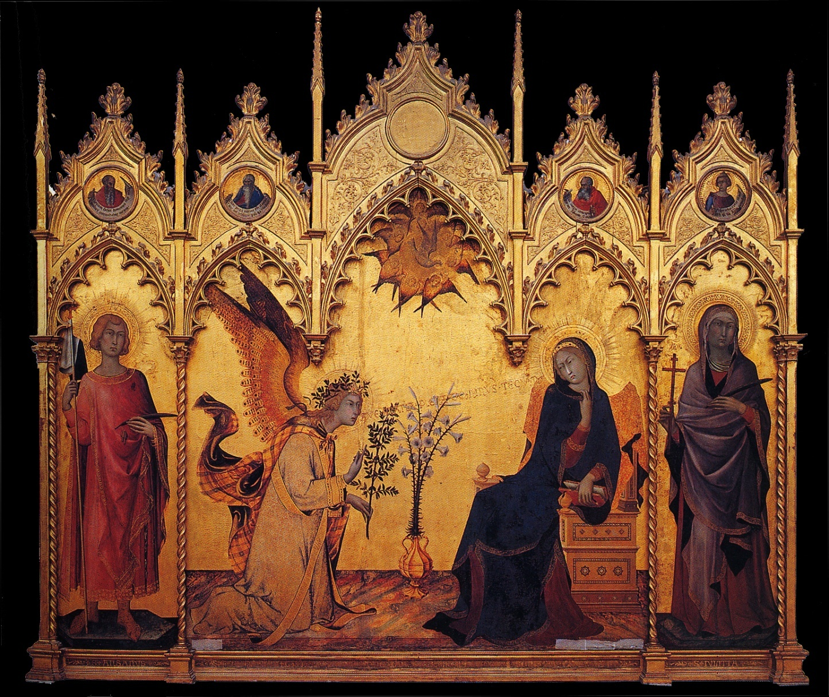
Simone Martini and Lippo Memmi
Annunciation
1333 tempera and gold leaf on wood 10 ft.1 in. x 8 ft. 8 3/4 in.
Notes:
Slide concept by William V. Ganis, PhD FOR EDUCATIONAL USE ONLY For publication, reproduction or transmission of images, please contact individual artists, estates, photographers and exhibiting institutions for permissions and rights.

Slide 16
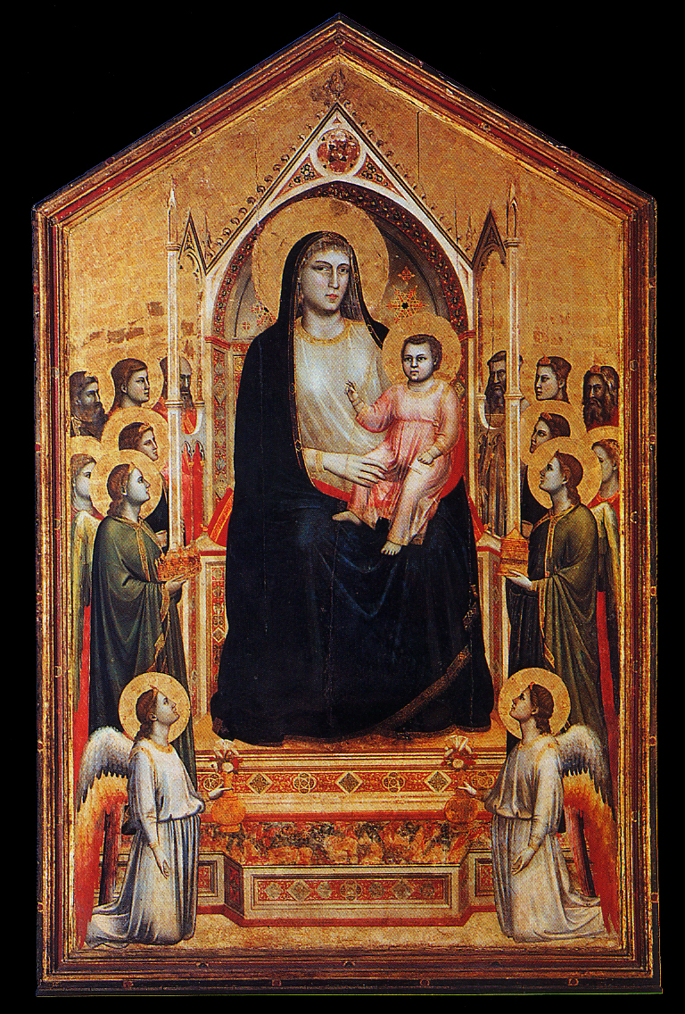
Giotto di Bondoone
Madonna Enthroned
ca. 1310 tempera on wood 10 ft. 8 in. x 6 ft. 8 in.
Notes:
Slide concept by William V. Ganis, PhD FOR EDUCATIONAL USE ONLY For publication, reproduction or transmission of images, please contact individual artists, estates, photographers and exhibiting institutions for permissions and rights.

Slide 17
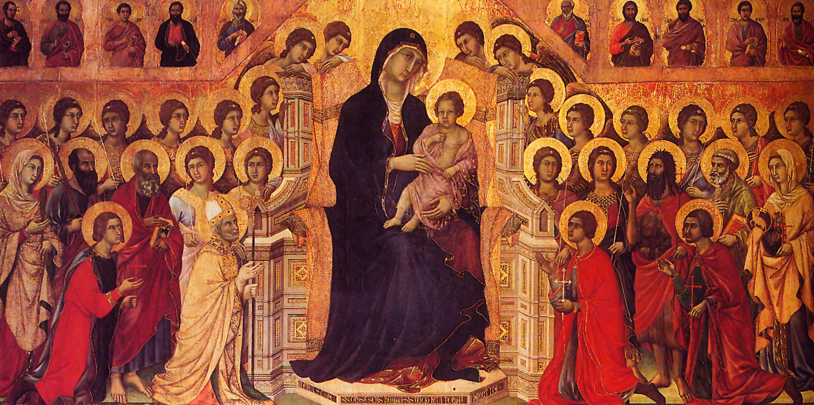
Duccio di Buoninsegna
Virgin and Child Enthroned with Saints from the Maestà altarpiece
from Siena Cathedral, Siena, Italy
1308-1311 tempera on wood 7 ft. x 13 ft.
Notes:
Slide concept by William V. Ganis, PhD FOR EDUCATIONAL USE ONLY For publication, reproduction or transmission of images, please contact individual artists, estates, photographers and exhibiting institutions for permissions and rights.

Slide 18
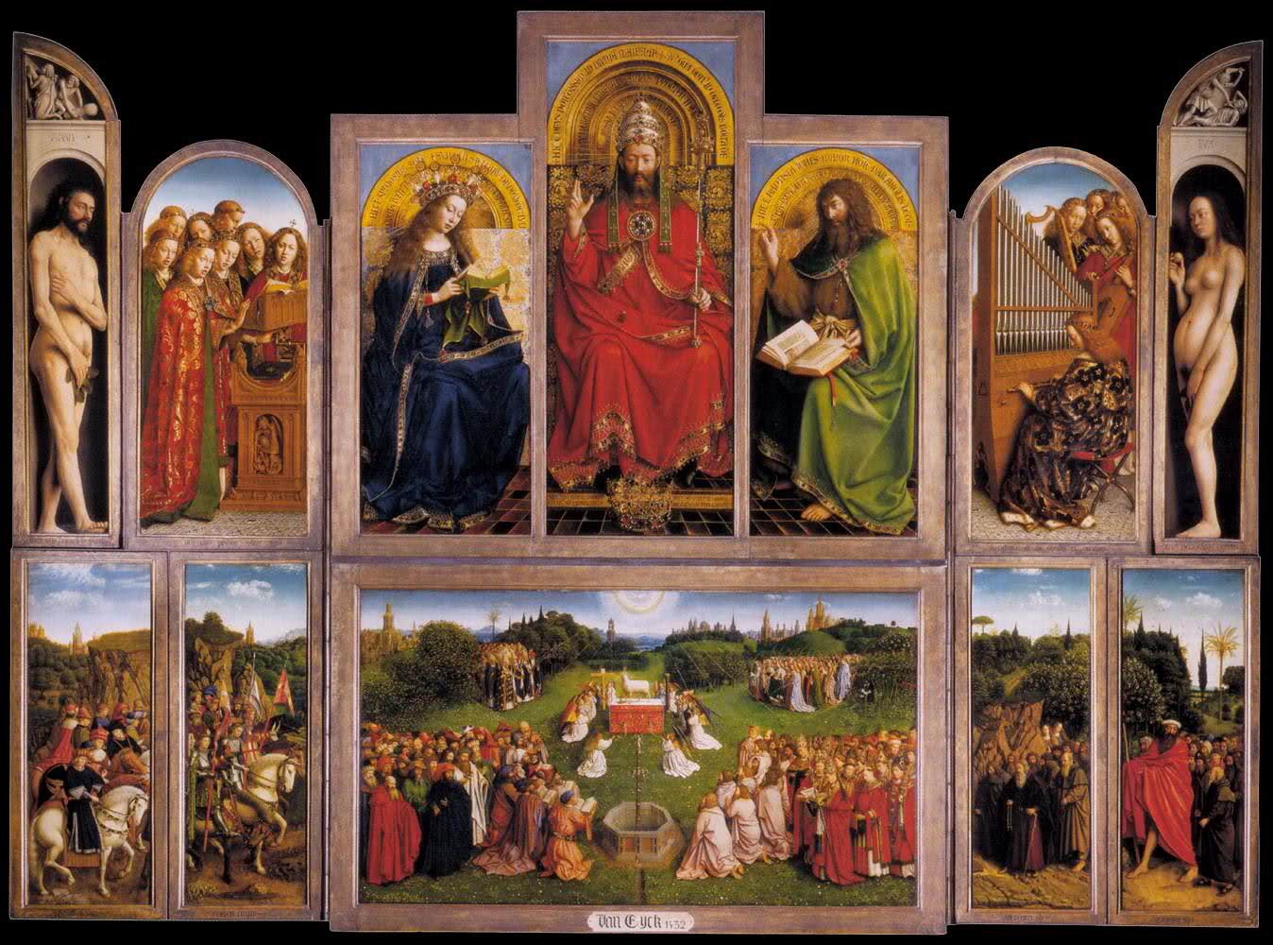
Jan Van Eyck
Ghent altarpiece
Notes:
Slide concept by William V. Ganis, PhD FOR EDUCATIONAL USE ONLY For publication, reproduction or transmission of images, please contact individual artists, estates, photographers and exhibiting institutions for permissions and rights.

Slide 19
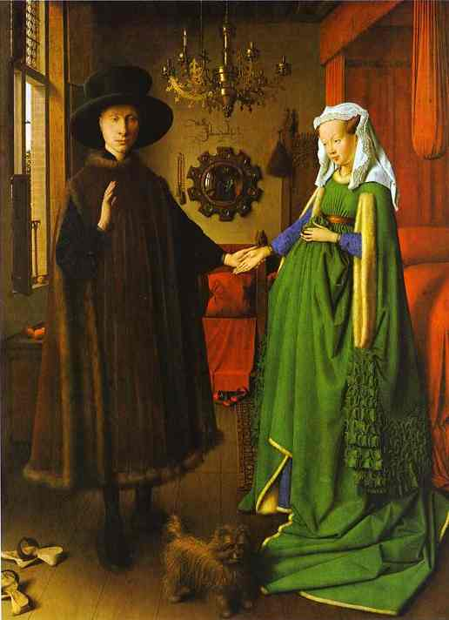
Jan Van Eyck
Arnolfini marriage
Notes:
Slide concept by William V. Ganis, PhD FOR EDUCATIONAL USE ONLY For publication, reproduction or transmission of images, please contact individual artists, estates, photographers and exhibiting institutions for permissions and rights.

Slide 20
ANY QUESTIONS?

